Slide 1
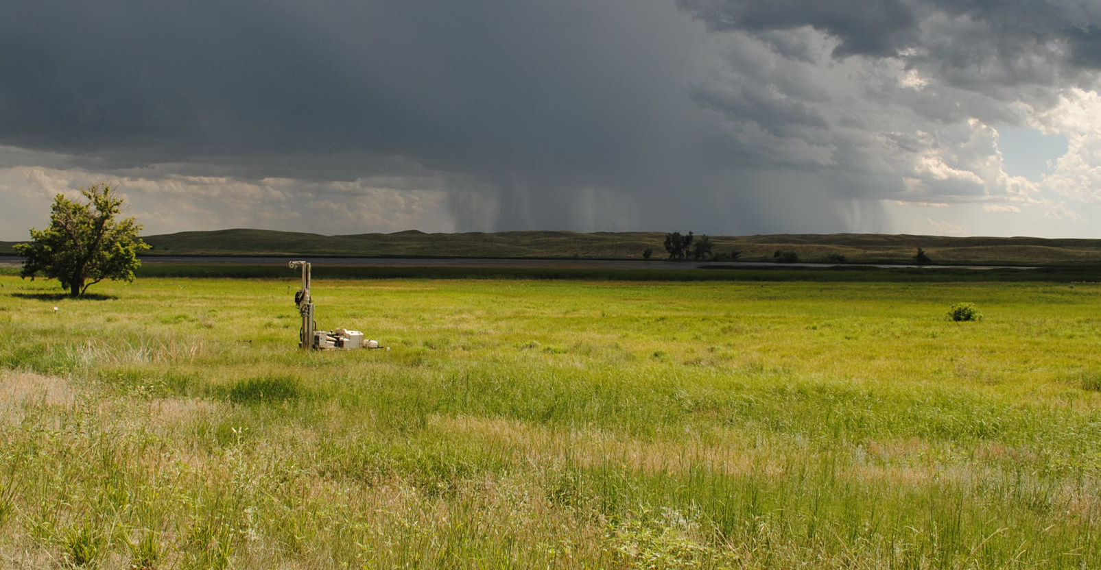
Groundwater Level Changes In Nebraska
Aaron Young
Geologist
Conservation and Survey Division
University of Nebraska-Lincoln

Slide 2
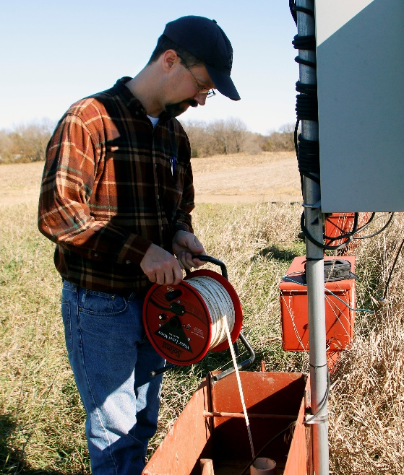
Nebraska Groundwater-Level Monitoring Program
Involves 30 State and Federal agencies
UNL-CSD
23 Natural Resources Districts
USBR
2 NE Public Power and Irrigation Districts
USGS
Annual readings in ~6,500 wells
Since 1900, CSD has accumulated:
About 800,000 hand measurements from more than 24,000 observation wells
Photo Credit: Shawna Richter-Ryerson

Slide 3
Nebraska Groundwater-Level Monitoring Program
Irrigation in Nebraska
8.6m irrigated acres of agricultural land
8.1m acre feet applied
7.4m acre feet from groundwater
More than 96,000 irrigation wells
0.7m acre feet from surface water sources
The prosperity of Nebraska’s economy depends on groundwater
Source:2017 Census of Agriculture
Top States in Irrigation
(Millions of Acres)
Nebraska | 8.6
California | 7.8
Arkansas | 4.9
Texas | 4.4
Idaho | 3.4
Kansas | 2.5
Colorado | 2.8
Montana | 2.1
Mississippi | 1.8
Washington | 1.7

Slide 4
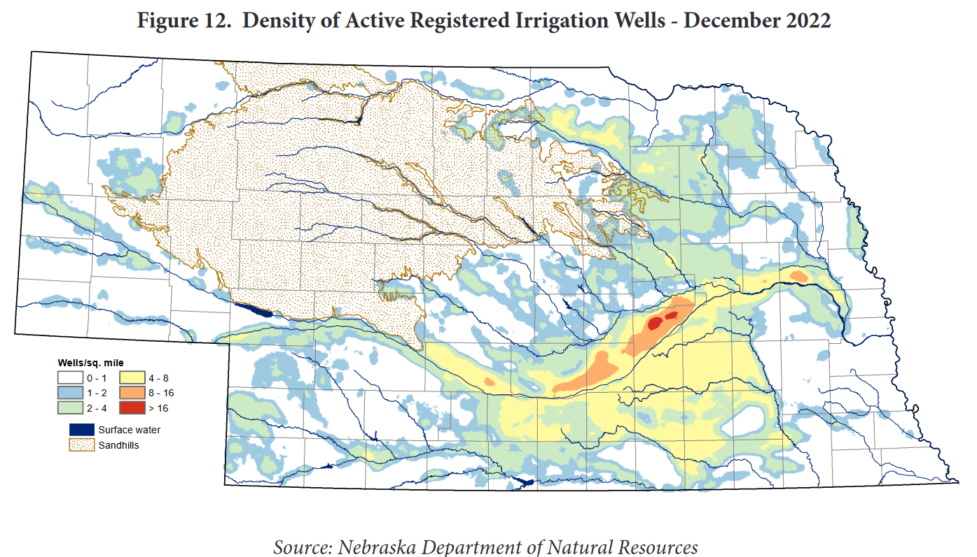

Slide 5
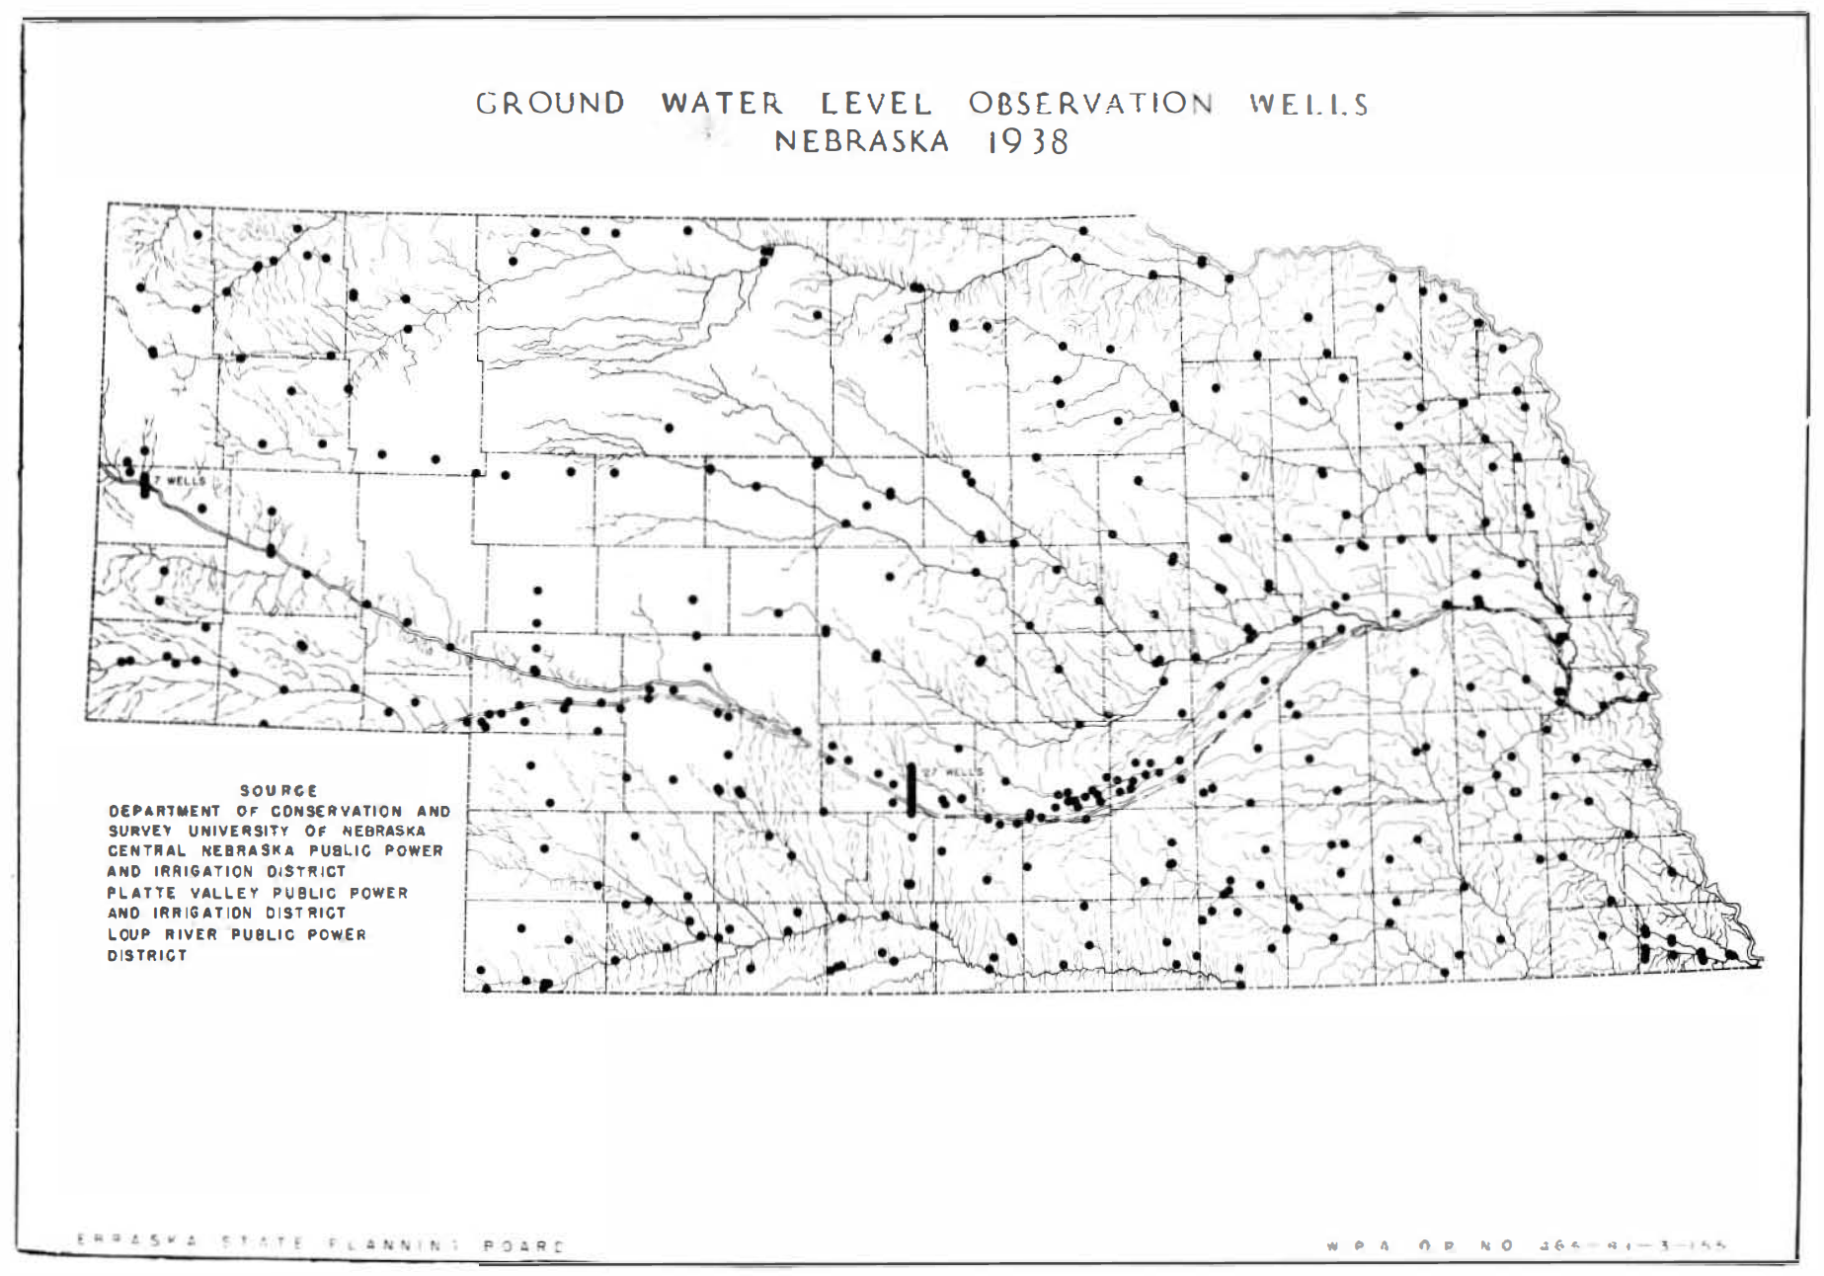
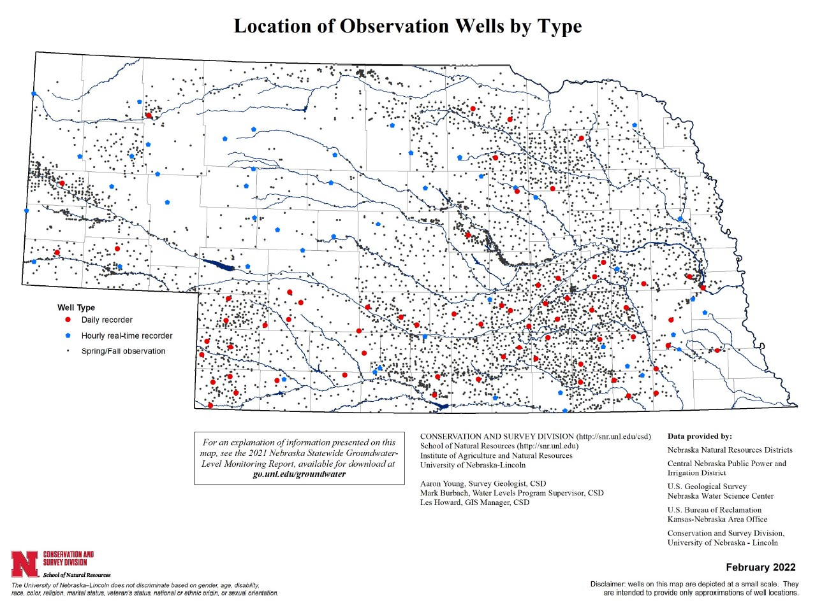

Slide 6
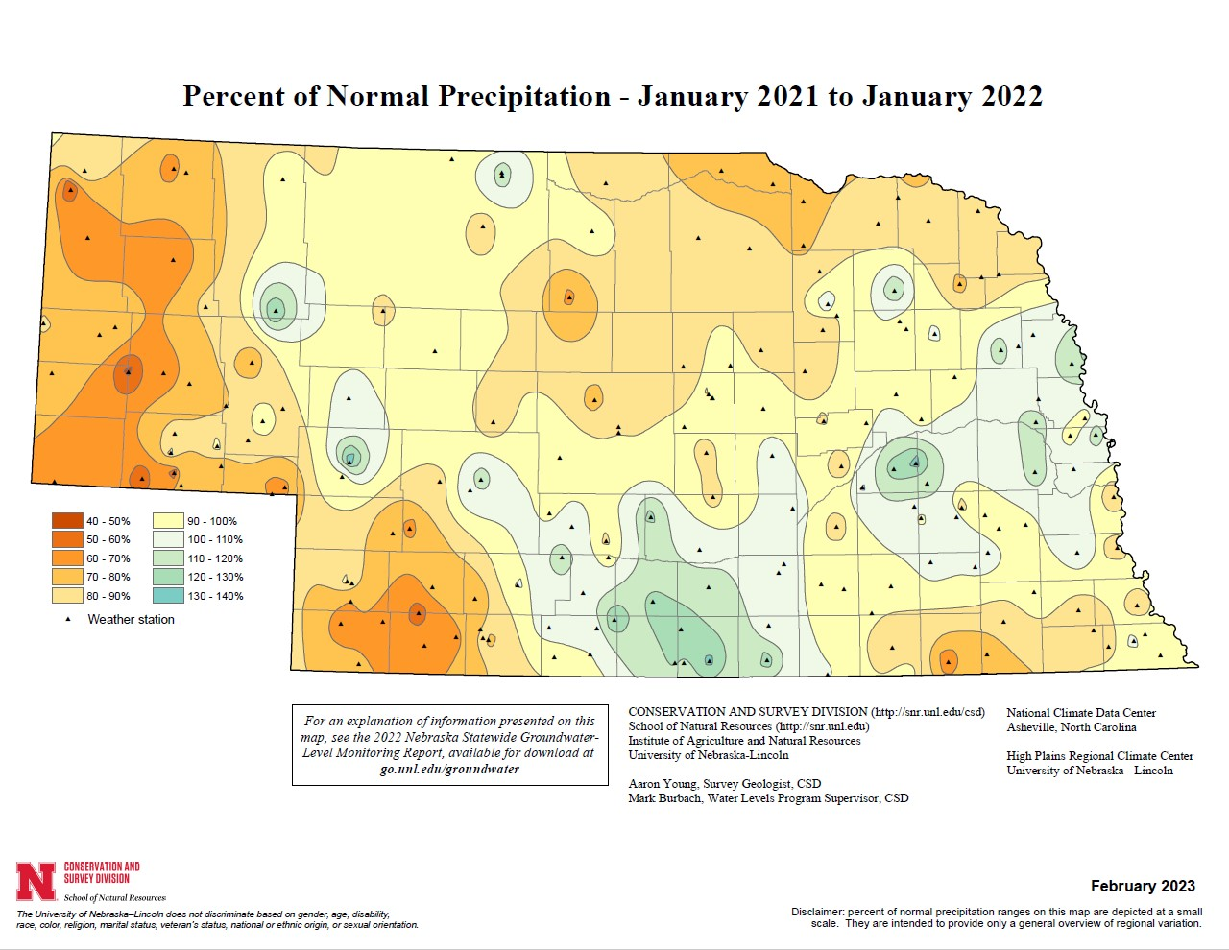

Slide 7
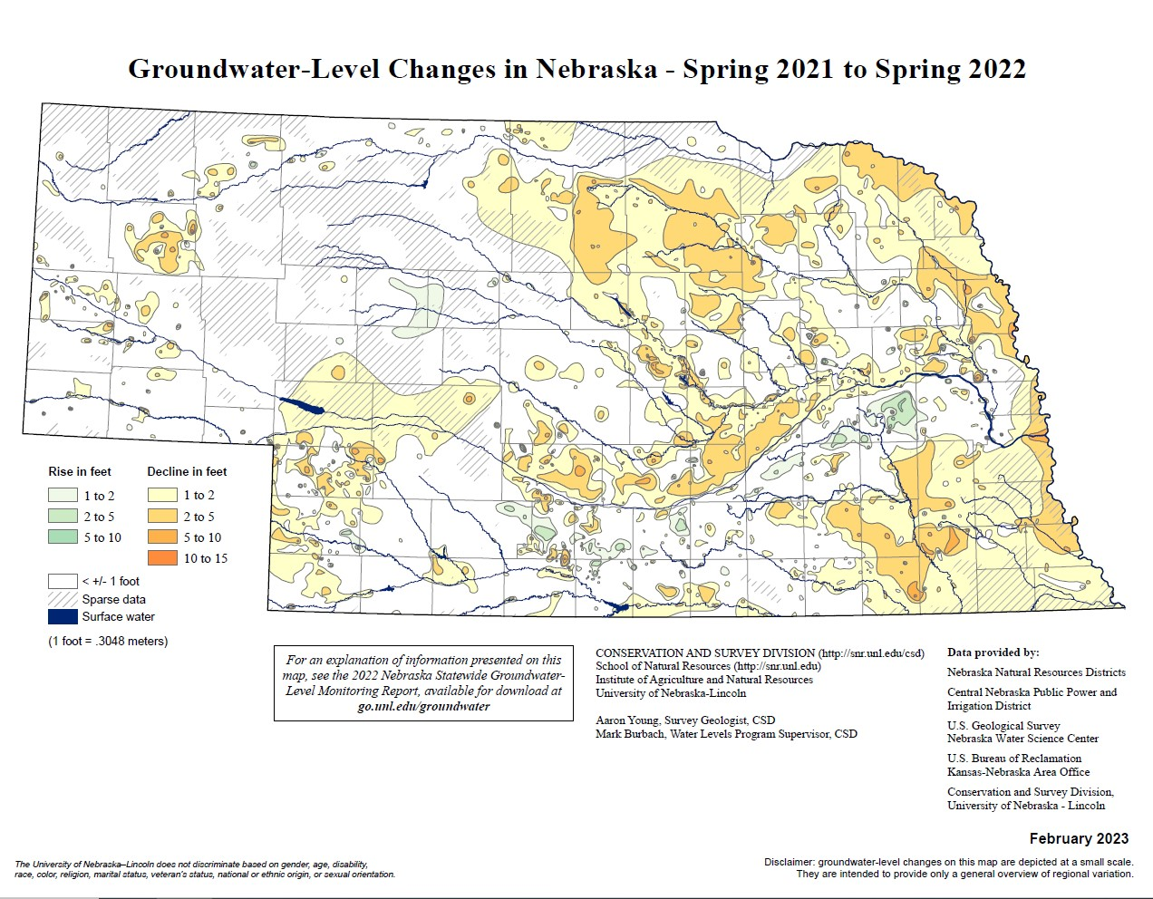

Slide 8
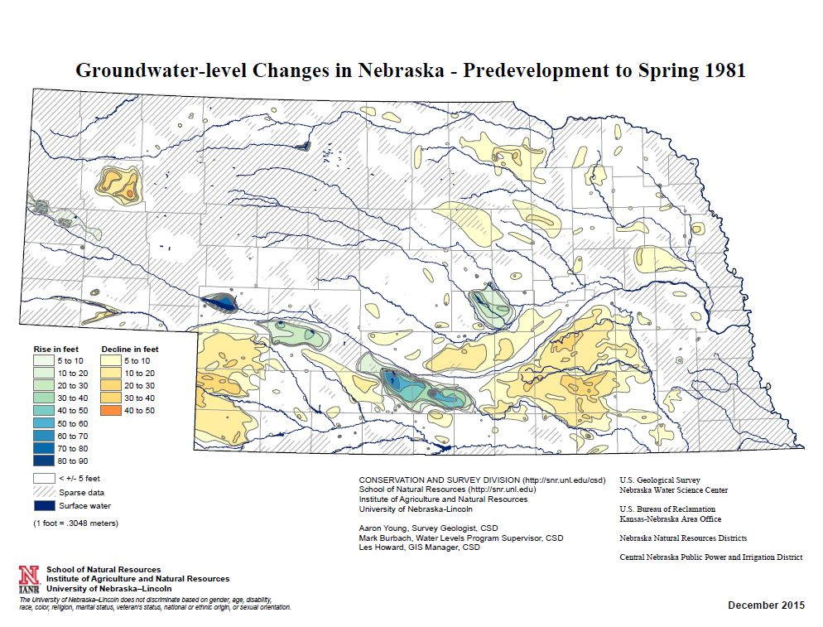

Slide 9
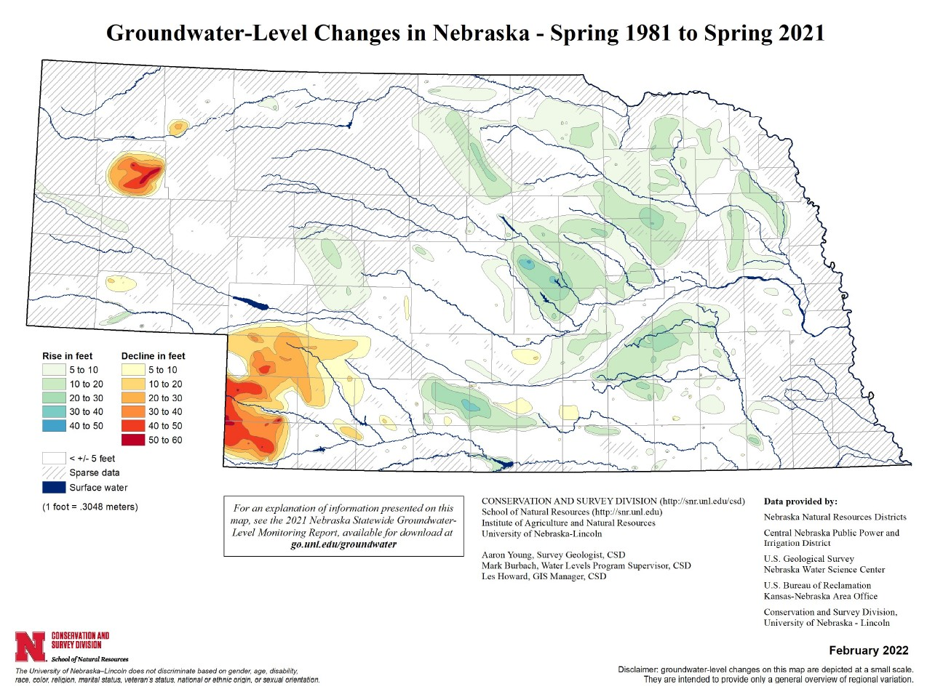

Slide 10
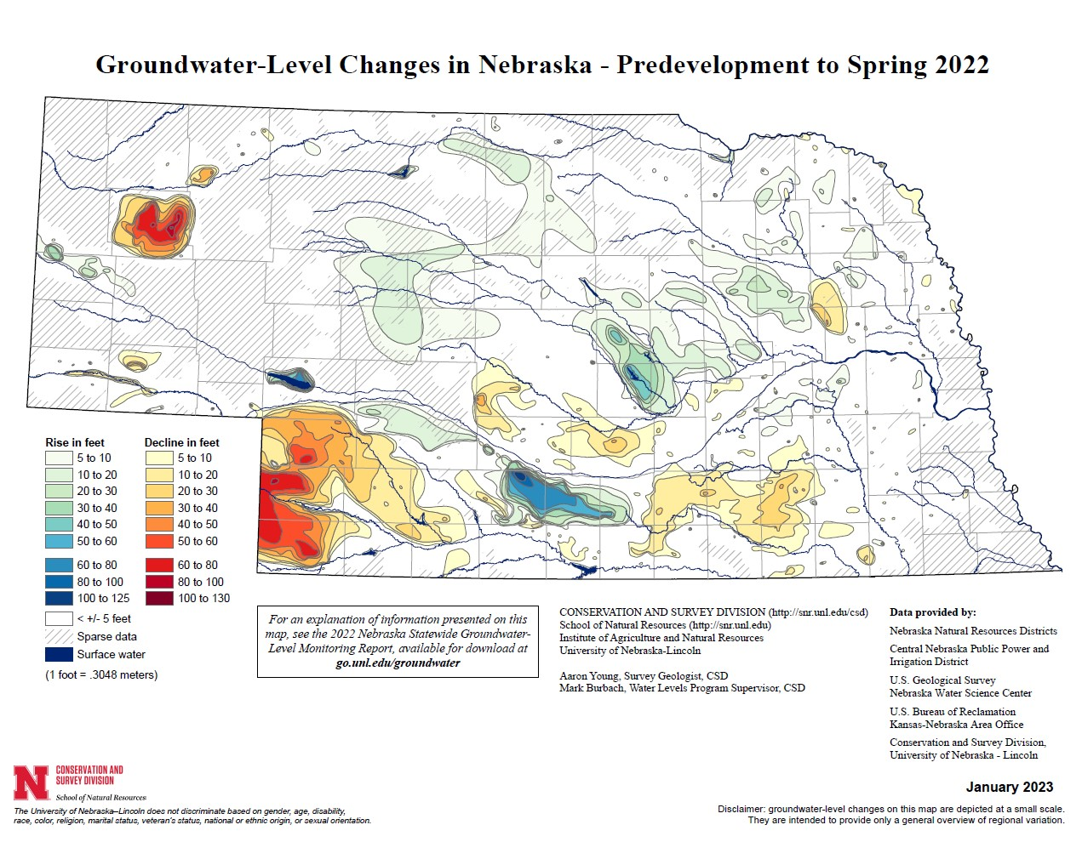

Slide 11
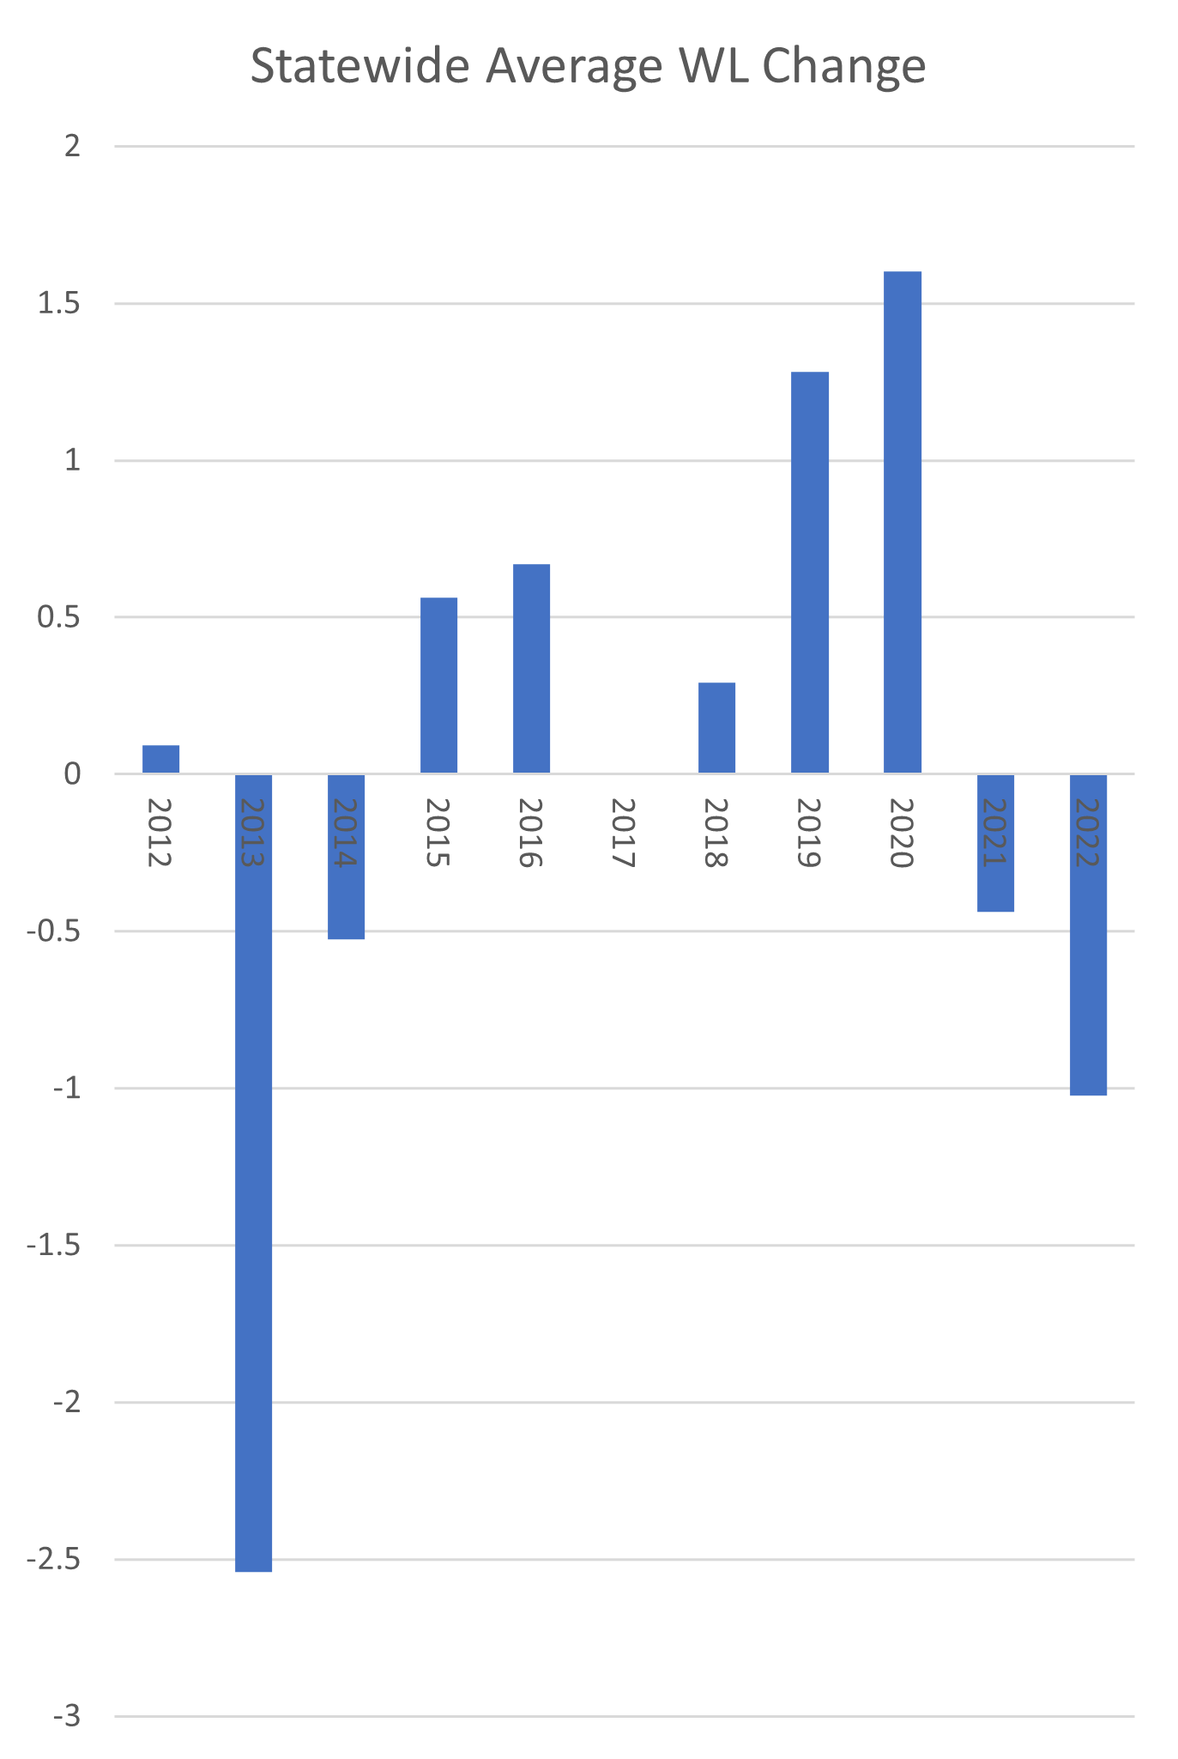
The Future…
Climate change and water levels…
GW levels in the west will continue to decline.
GW levels in the Sandhills will continue to rise or remain steady.
GW Levels in the east-
Levels will become more variable based on annual climate variability.
The impact of drought events have greater impact on GW than extreme wet events.
Long term impacts of climate extremes on WL’s are difficult to predict.

Slide 12
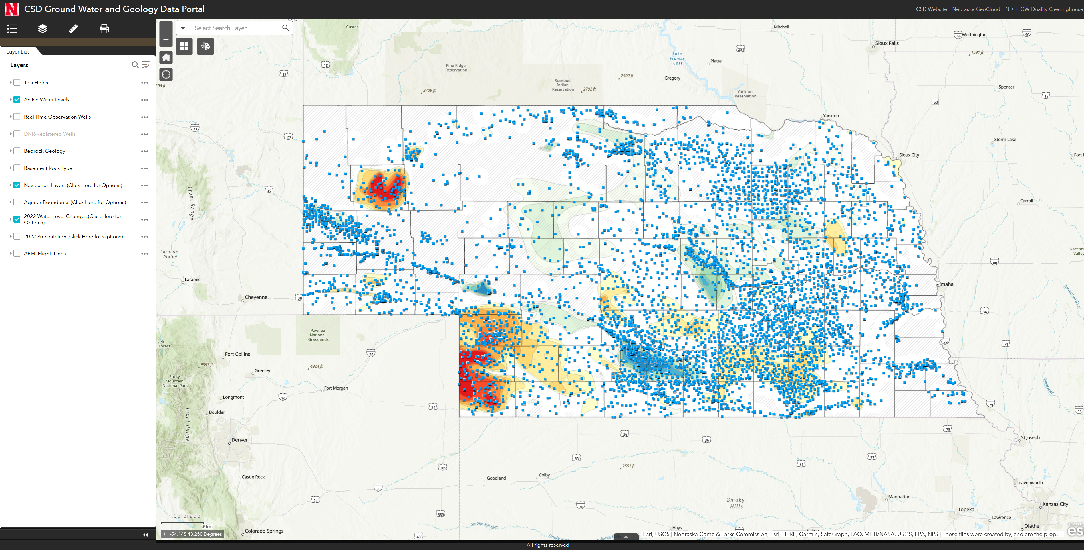
More Information
Aaron Young
ayoung3@unl.edu
402-472-8339
https://snr.unl.edu/csd/map/

